Slide 1

Everything on the Dark Web is Dumb
Johnny Xmas | @j0hnnyXm4s

Slide 2

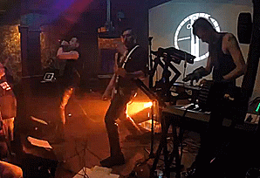
Who is this Dark Wizard?
The 3D-Printed TSA Keys Guy
Penetration Tester
Goth-Industrial Musician

Slide 3
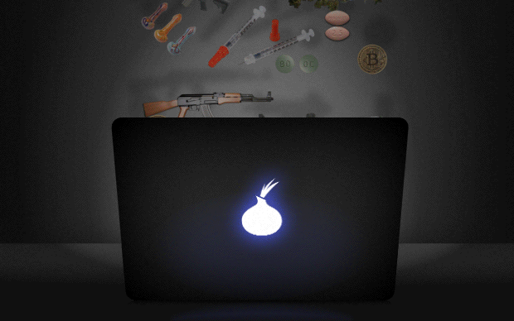
Today’s Topics:
Darkweb
Darknet
Deepweb
Deepnet
DeepDark
DarkDark
DankNet
DerpNet
R’lyeh

Slide 4
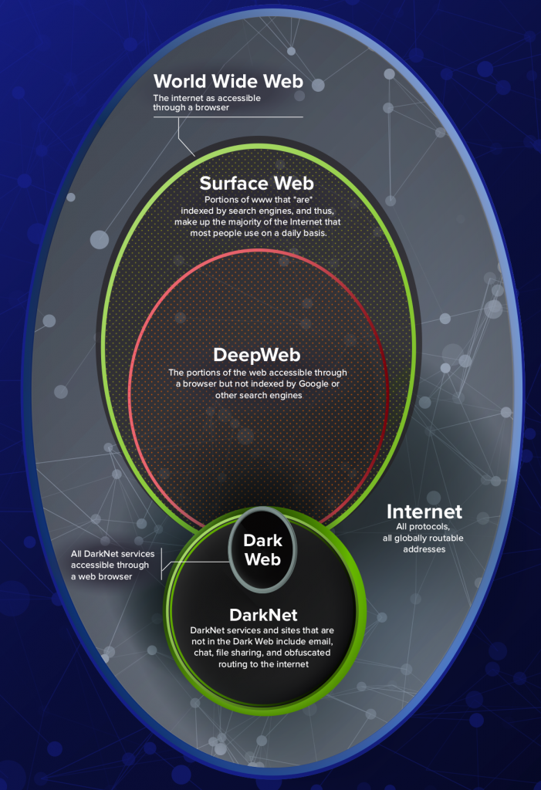
Notes:
Deep Web - Pages on webservers that do not require special access rights to reach, but which are not indexed by major search engines such as Google. If a dictionary site (to give an example) were part of the Dark Web, then you could find the dictionary site itself in Google, and could type a word into the site to get the definition, but Google itself would not show that definition if you searched for it.
Dark Web - These are pages on servers that cannot be accessed by a search engine (or indeed, a user) without an approprately permissioned account. While a number of sites of law enforcement interest do in fact fall under this definition, so do a much larger number of private sites, particularly those behind paywalls
Dark Net(s) - These are sites where access at the network level is restricted; some are things like TOR (where there is a layer of obscurity) but equally private vpn based networks (which are pretty standard for most companies these days) are examples of Darknets; traffic in them is hidden at the metadata level, in that snooping shows only what Darknet you are connected to and how much data is moved, not what sites you visit.

Slide 5
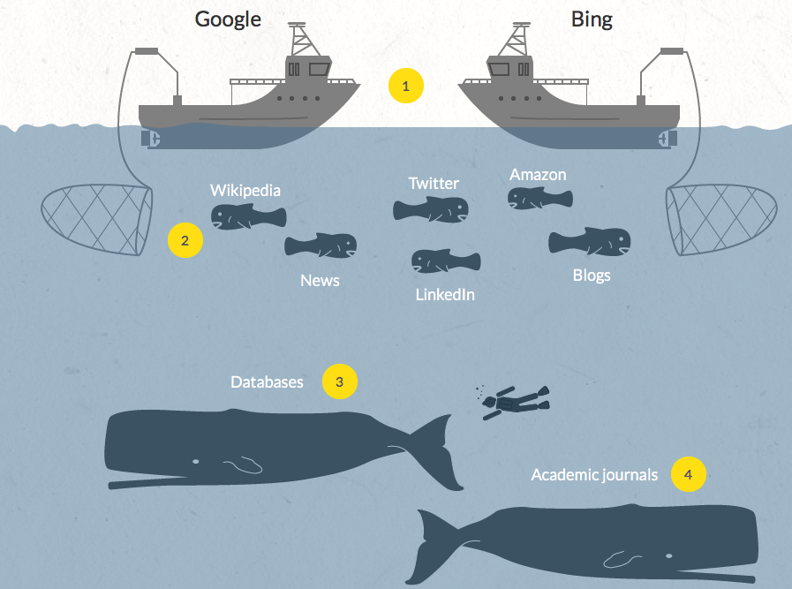

Slide 6
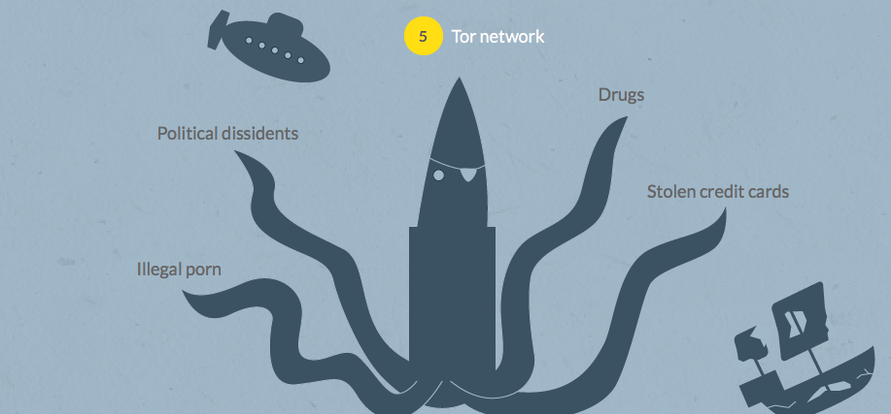

Slide 7

Notes:
OK SHUT UP LETS BUY THINGS

Slide 8
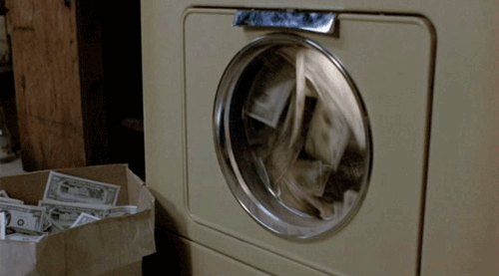
OK, But First:
Notes:
Cryptocurrency / money launering

Slide 9






Notes:
While Eastern European groups tend to still love their Perfect Money, OKpay, and WebMoney services, within the past few years darkweb economies have shifted more and more to cryptocurrencies.
Bitcoin and Monero currently dominate the scene with Zcash expected to have high uptake upon launch due to its privacy assertions

Slide 10
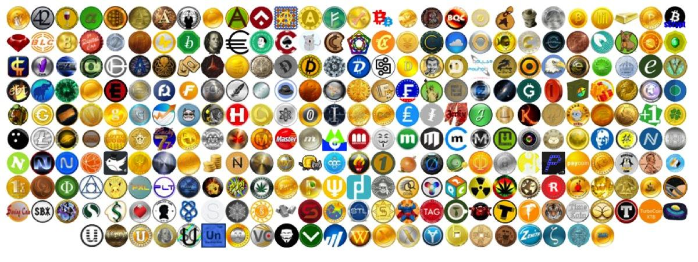
Notes:
That isn’t to say that there aren’t many, many, other options to choose from...

Slide 11
LET’S GET READY TO TUMBLE!
Notes:
Cryptocurrency / money launering

Slide 12
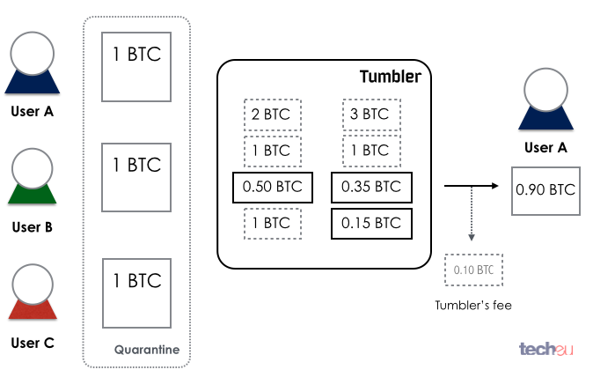
Notes:
Once you’ve acquired your cryptocurrency of choice, be it through a private transaction or a public exchange house, you are probably going to want to obfuscate the transaction trail a bit by using a tumbling service

Slide 13
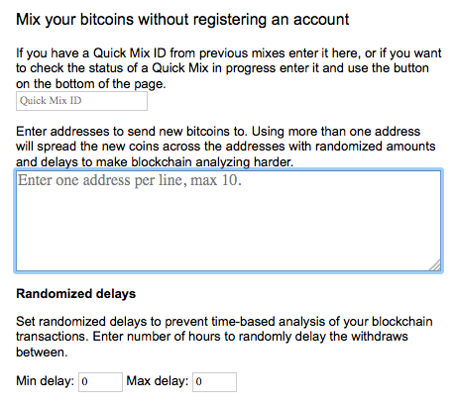

Slide 14
OK SRSLY
Notes:
OK FOR REAL LETS BUY THINGS

Slide 15

HOW TO BUY:

Slide 16



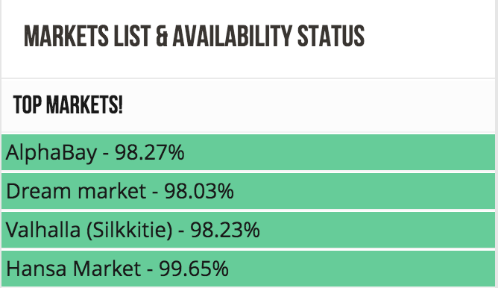
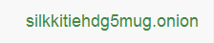

























?
?
Notes:
You could try going to each of the over 30 active markets individually to search for your poison of choice, or...

Slide 17
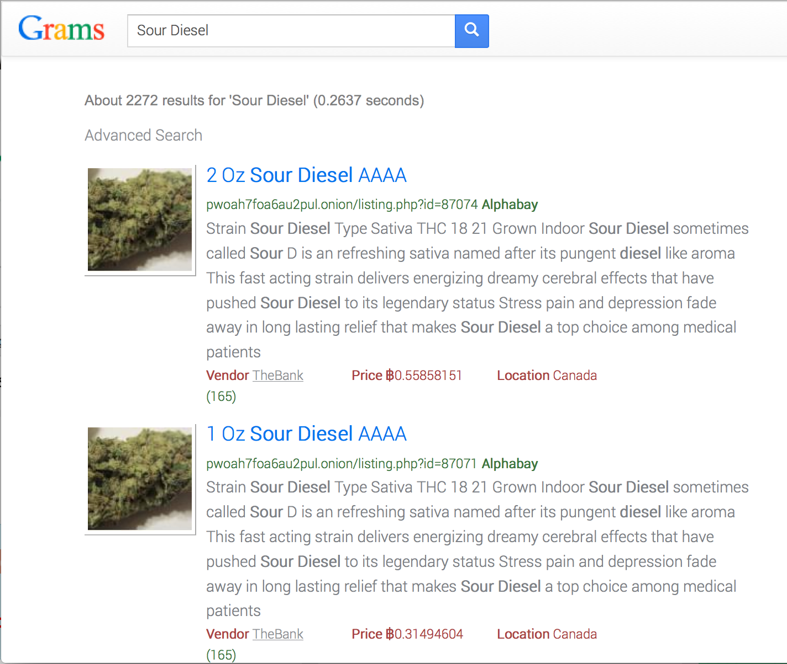
Notes:
Or you can use the Grams search engine to search across a bunch of markets at once.

Slide 18
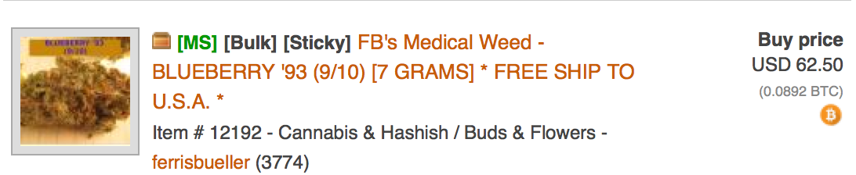
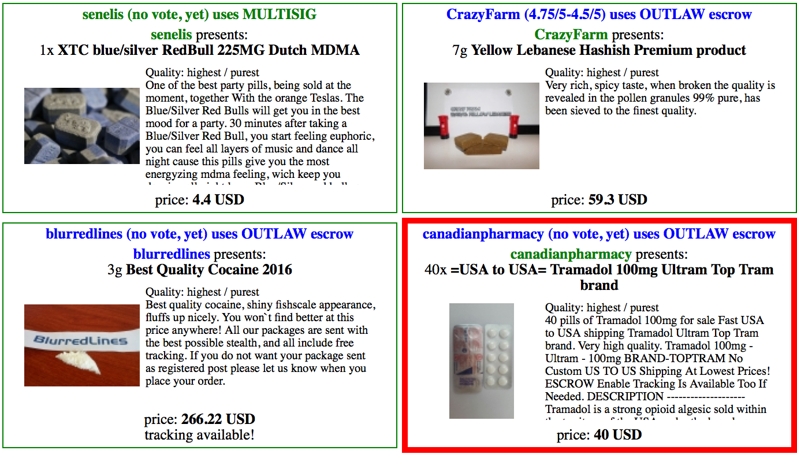
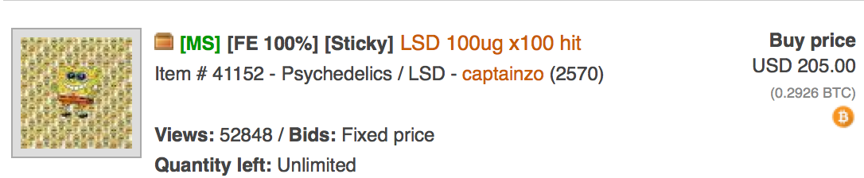
Notes:
The types and varieties of drugs available is rather astounding. This ain’t your neighborhood plug’s inventory. So of course you have your street staples: weed, molly, hash, blow, acid, special K, crack, ice, opiod pain meds, research chemicals, etc.

Slide 19
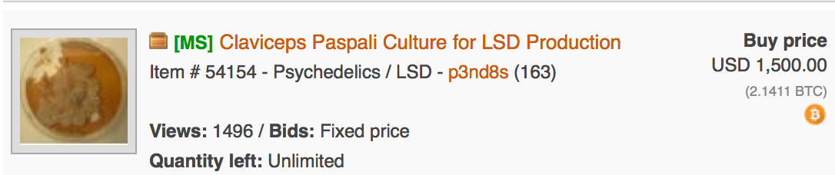
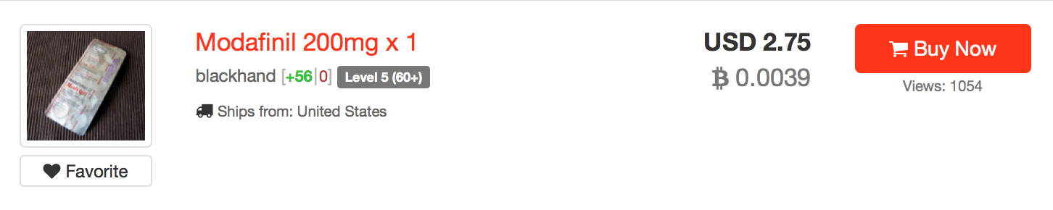
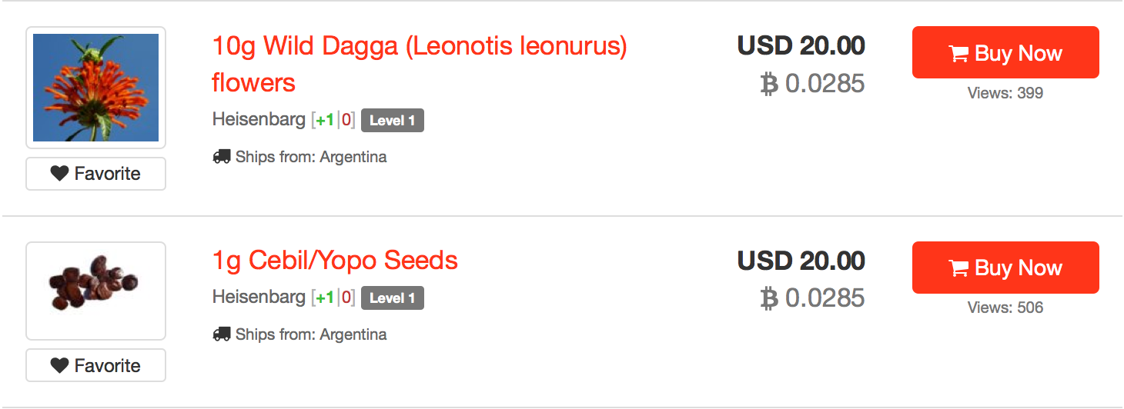
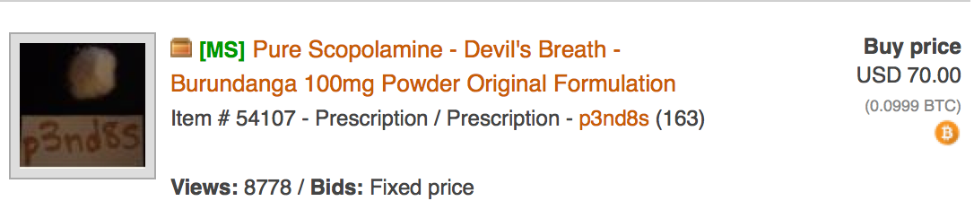
Notes:
But there are also other interesting items on offer. Things like chemical precursors and lab equipment, military enhancement drugs, non-mainstream medicinal herbs, Devil’s Breath: often used for robberies and kidnappings in South America...

Slide 20
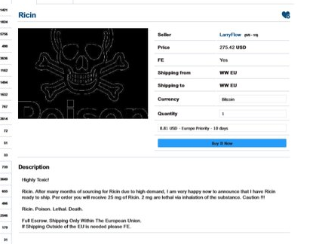
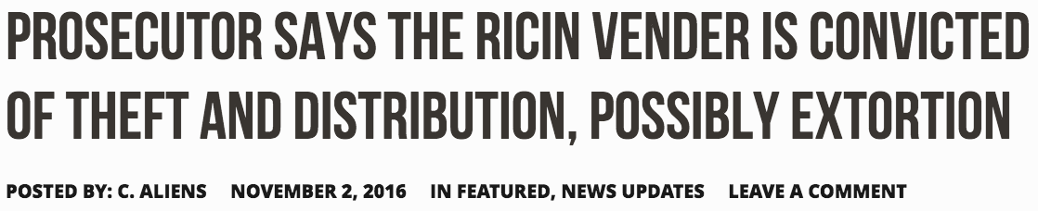
Notes:
And, yes, you can even purchase actual poison...

Slide 21
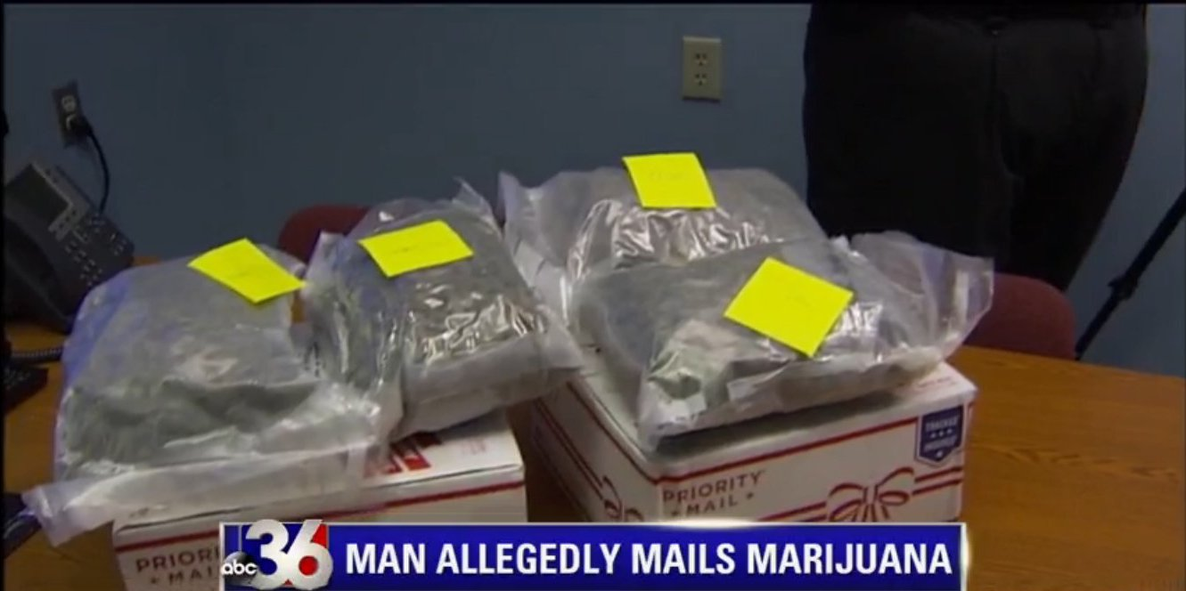
Notes:
All that being said, you still have to have a physical location to receive your orders, and no matter what a seller tells you there is no such thing as “100% stealth shipping”. Packages can and do get seized and in some cases get used as bait in a controlled delivery by law enforcement.

Slide 22
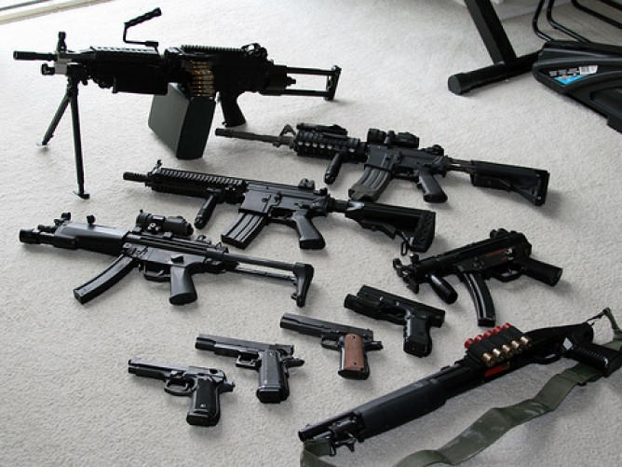
HOW TO BUY:

Slide 23
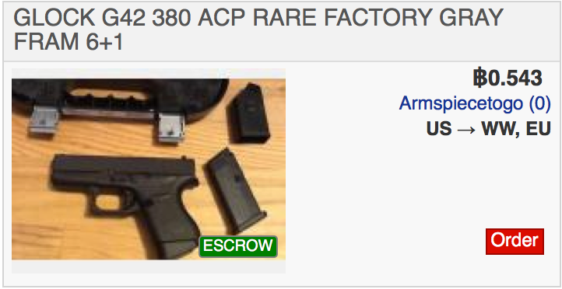
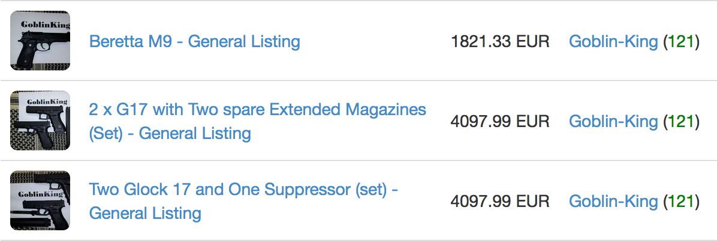
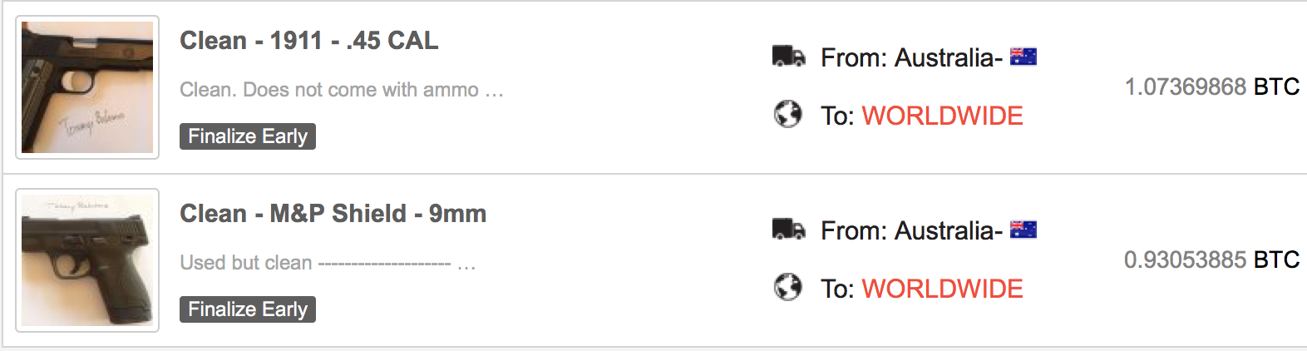
Notes:
While guns can certainly be found for sale on the Darkweb, most of the markets are starting to ban their sale due to high levels of scamming and additional heat from law enforcement.

Slide 24
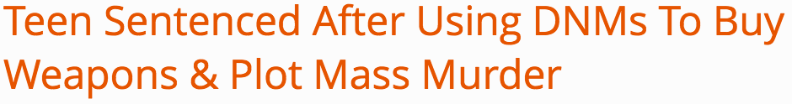
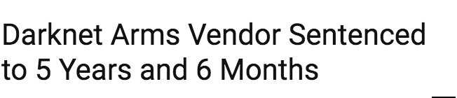
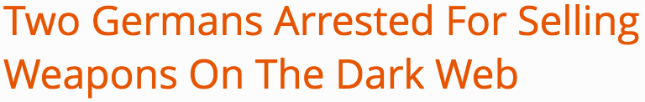
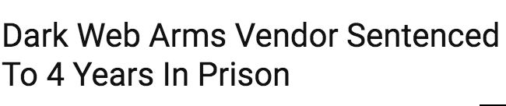

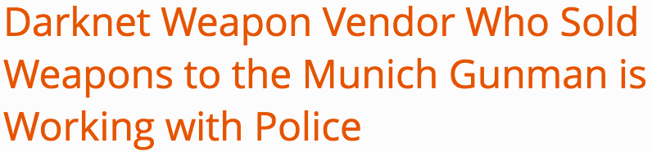
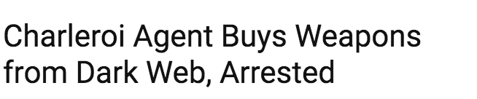
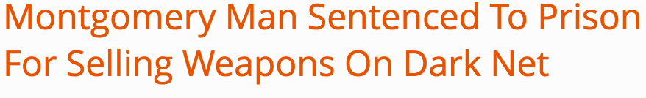
Notes:
Within the past year law enforcement around the world have been focusing on darkweb munitions sales as part of the global War on Terror (which means sketchy tactics like entrapment are allowed). Heat from the Man isn’t the only thing driving a shrinking darkweb arms market, demand is also sorely lacking as purchasing weapons using cryptocurrency through a darknet and from a shady stranger is often much more difficult and risk filled than following local, legal channels for gun ownership. This of course depends on where you live and what your intended uses are.

Slide 25
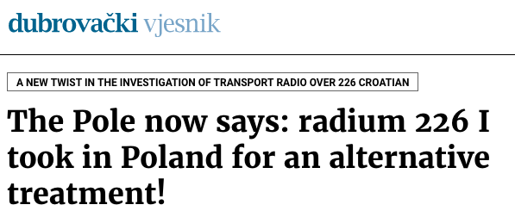
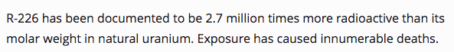
Notes:
Guns arent the only weapons you can buy tho. . . . .

Slide 26
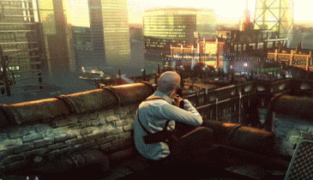
HOW TO BUY:
Notes:
So I’m sure you’ve read at some point a sensationalist media piece going on about how you can buy anything and everything horrible in this world including… GASP! HITMEN to off your enemies. Hell, even The Dread Pirate Roberts of the infamous Silk Road was accused of trying hire one.

Slide 27
YOU DON’T.
PERIOD.
THE END.
Notes:
No really, just as Dread Pirate Roberts found out this just isn’t a thing. Any listing for such a service found on the darkweb is going to be either A) a scam to part fools and their money, or B) Undercover law enforcement hoping for low hanging fruit.
While I can see organized crime moving to use a darknet to arrange hits in a few years we just aren’t at the cyberpunk future where any ol Joe can order up a personal iceman through the darkweb. Additionally, a legit hitman is not going to take on the liability of performing a hit for some 15 year old pissed off about another XBOX Live player, they are generally going to stick to business with clients who know what they’re doing.

Slide 28
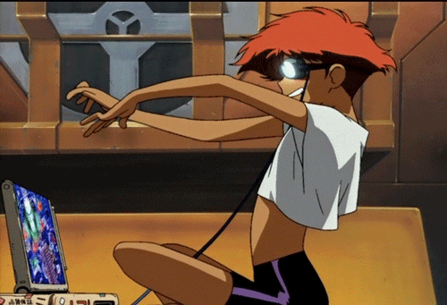
HOW TO BUY:
Notes:
While you may not yet be able to purchase physical hitmen you can still hire the services of digital ne'er do wells to do your bidding

Slide 29
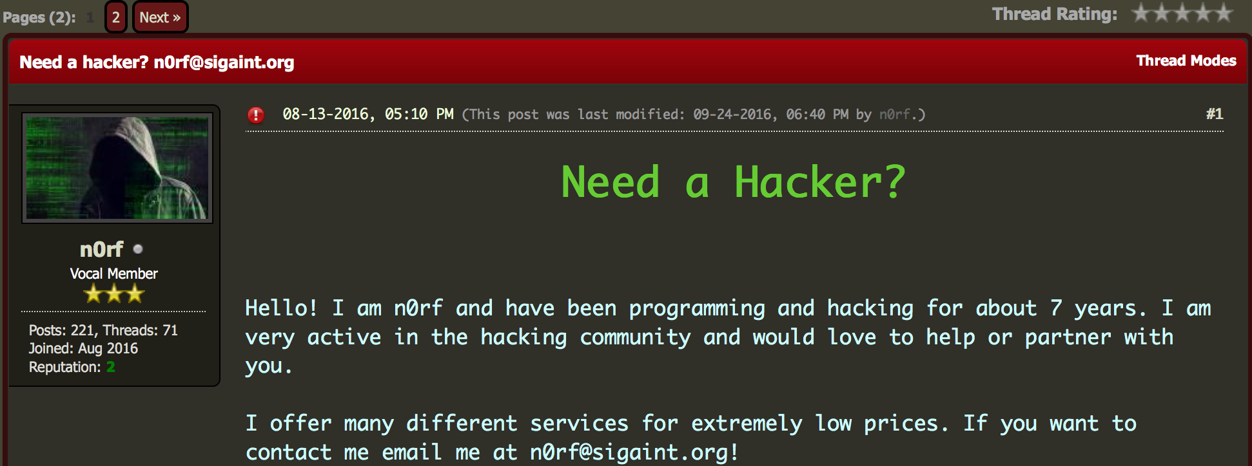
Services
- Account Hacking: 0.08 BTC
- Database Hacking: 0.5 - 0.17 BTC depending on the database size.
- Website Hacking - Depends on site
- Other: Grade change? Yes. DDos? Yes. Doxing? Yes.
Notes:
You can hire a hacker to crack someone’s social media or email account, a particular website or database. You can also have them change grades for you, DDoS a target of your choice, or Dox someone giving you a packet of detailed personally identifiable information on someone.
SIGAINT IS DOWN

Slide 30
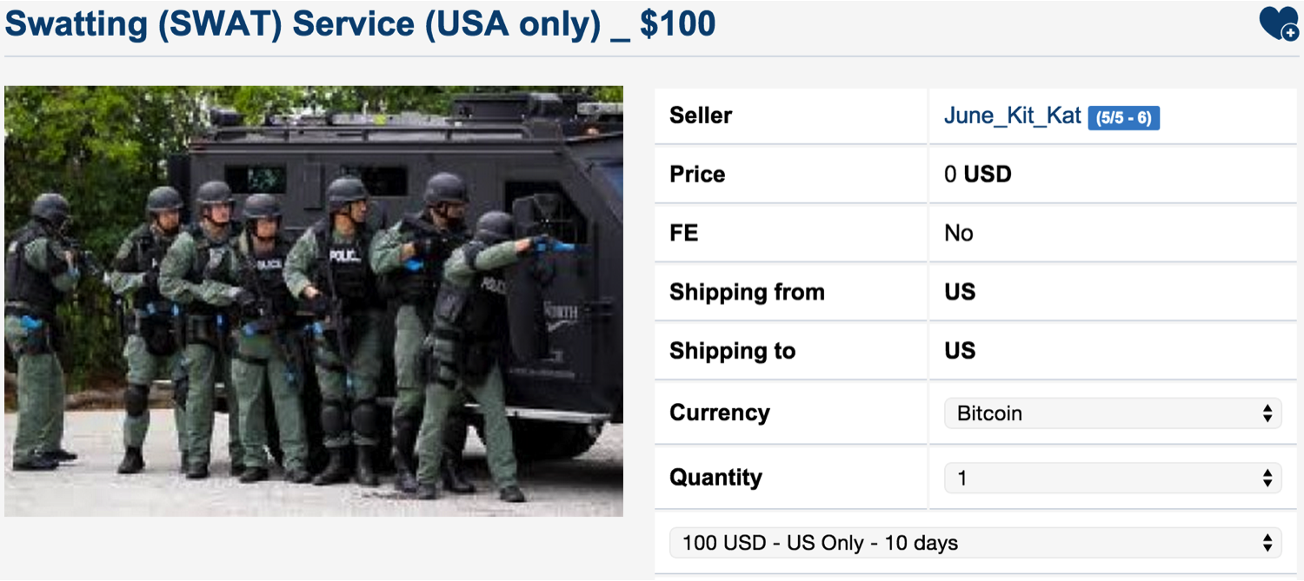
Notes:
Another of such services on offer is the new SaaS, that’s Swatting as a Service. Here you can hire someone to get a heavily armed SWAT to raid the target of your choice. There are also less physically invasive services that will repeatedly call or text a target from a rotating bank of phone numbers.

Slide 31
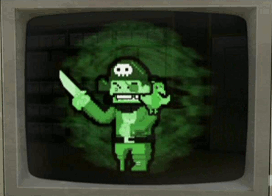
HOW TO BUY:
Notes:
A step up from basic hacking services, you can also purchase more sophisticated digital offerings for cybercrime shenanigans.

Slide 32
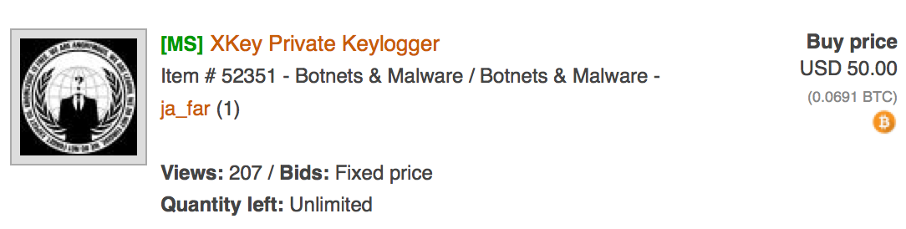
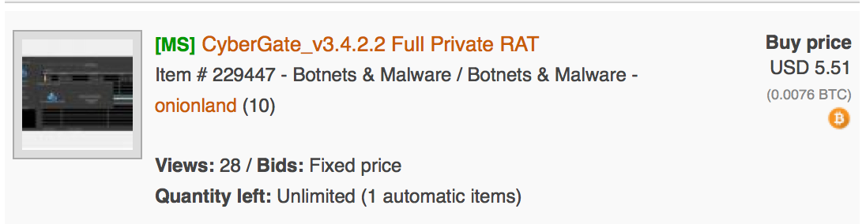
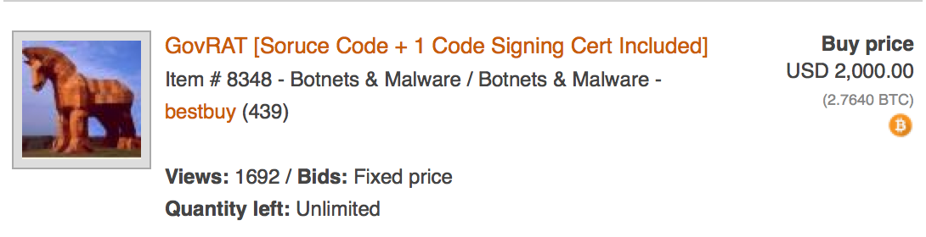
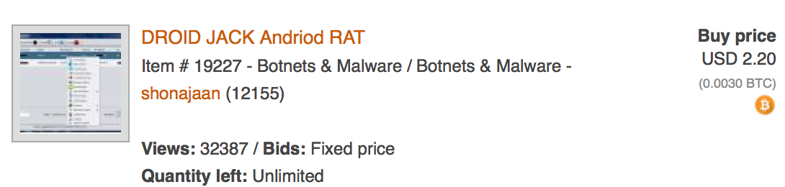
Notes:
Plenty of Remote Access Trojans and keyloggers are available including those that target mobile devices. The prices for these range from a couple dollars to a couple thousand depending on capabilities, detectability, crackability, and source code availability.

Slide 33
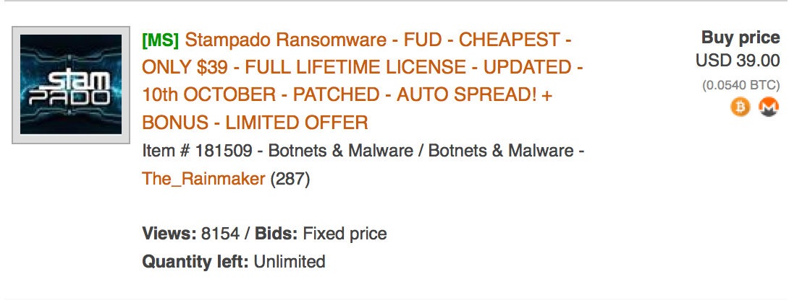
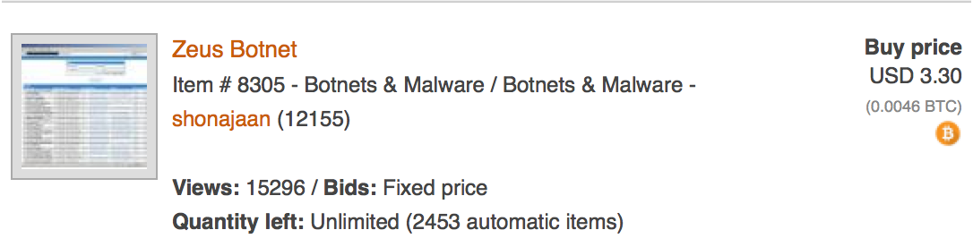
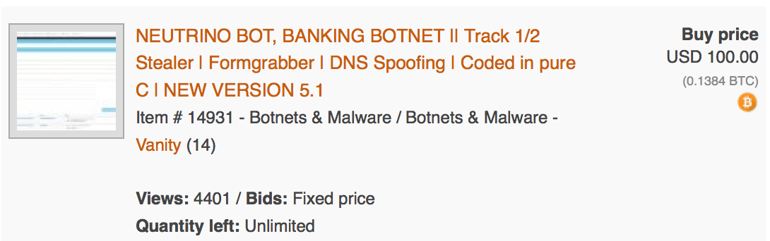
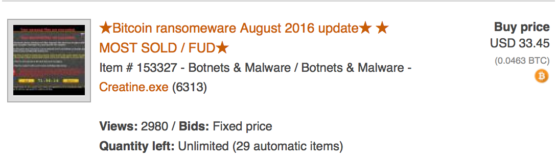
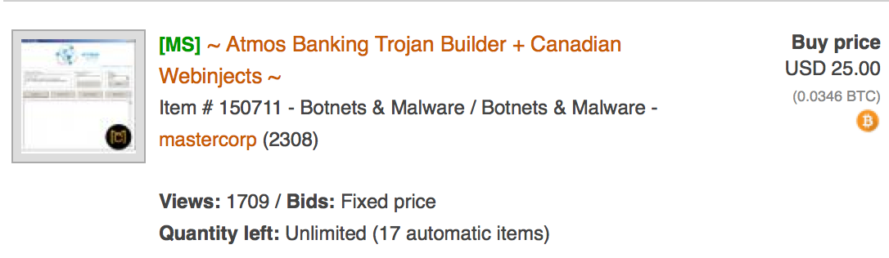
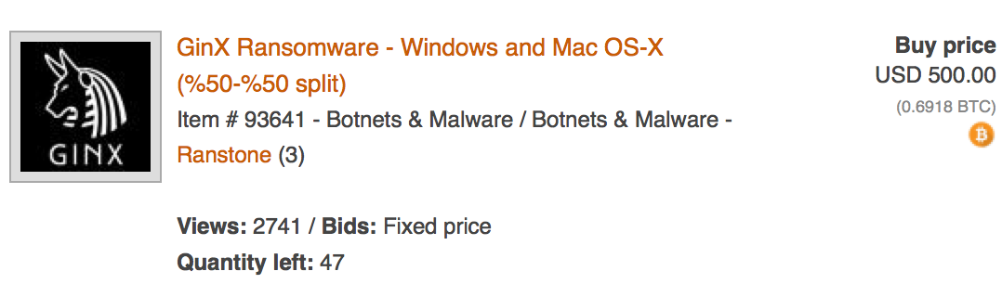
Notes:
Ransomware and banking trojans are also available, though naturally they tend to be a bit pricier than RATs and keyloggers.

Slide 34


Notes:
Don’t want to mess with the leaked Marai sourcecode? No worries, there are plenty of other, non-cracked, botnet programs for sale.

Slide 35


Notes:
Need a specific class of exploit? Also available. Even 0dayz.

Slide 36


Notes:
Feel like skipping a few steps and going straight to where the cash and credit cards are? The darkweb’s got you fam with Point of Sale and ATM malware ready to go.

Slide 37


Notes:
Burning desire to show that XBOX Live loser who the real boss is? Spamming and DDoS software is at your leet little fingertips. Just make sure you’re behind seven proxies.

Slide 38

HOW TO BUY:

Slide 39





Notes:
Srs bzns: counterfeit gold, currency, and your very own funny money manufacturing supplies...

Slide 40




Notes:
As you’d expect from any decent counterfeit outlet you have your pick of designer watches, jewelry, glasses, shoes, purses, and clothing items...

Slide 41


Notes:
And now to the not-so-expected: counterfeit degrees and counterfeit Magic the Gathering cards. That’s right you could have a PHD from Harvard and your own set of Power Nine in one go.

Slide 42

HOW TO BUY:
Notes:
So now that you have a bunch of counterfeit goods you might as well round it out with a counterfeit identity!

Slide 43


Notes:
Start off with a fullz packet, that is a full identity information workup. These typically include full name, date of birth, physical and email addresses, phone numbers, social or national ID number, and the like. And PII profiles are available for many different countries around the world and you can often specify what age range and sex you want.

Slide 44



Notes:
You can flesh the identity out a little further with customizable bank statements, utility bills, and a full credit report!

Slide 45



Notes:
Now to secure physical documents matching your new ID. When combined, physical docs and fullz together make what are called kitz. Custom driver’s licenses and school/work ID’s won’t set you back too much, but the passport, now that’s the real doozie as the current market average runs a little of $3000 for a customized passport.

Slide 46



Notes:
Or if you just need to provide a scanned copy of IDs or passports you can just buy Photoshop templates for them!

Slide 47

HOW TO BUY:
Notes:
So unless you’ve been under a rock you probably noticed the media coverage of one massive data breach after another these past few years. If you have an account checking campaign about to pop off this is where you’d go to get massive lists of account credentials.

Slide 48



Notes:
Now what makes these massive breach dumps valuable is not necessarily for access to the accounts of the hacked website. The value comes from the fact that so many people reuse login credentials across many many different website allowing such criminals to access say a Paypal account using the credentials from the Yahoo breach.

Slide 49








Notes:
You want free Uber rides, don’t want to pay for Netflix or Spotify, or want free paid porn (for some weird reason beyond me) you can slide right up to the Darkweb markets and get those hacked account logins on the cheap cheap.

Slide 50


HOW TO BUY:
Notes:
Shell companies are useful to cybercriminals for a number of reasons. They provide a cover, front, or proxy for some of their shady actions. They can be used to cashout on a scam or crime. They can be used to launder money meant to be reinvested in the next criminal enterprise. They can be used to make a criminal look legitimate for scams that target CEOs or other businesses.

Slide 51



Notes:
While you certainly can buy shell companies and business bank drops from the darkweb, the quality tends to be… found wanting for now. Truthfully, shady lawyers still control the bulk of this market and they aren’t too difficult to find and hire to provide you with all you would need to run a shell corp of your own.

Slide 52

HOW TO BUY:
Notes:
Sadly, there is still a large and thriving global market for human trafficking. As such it would make sense that such a market would make use of the darkweb right?

Slide 53



Notes:
Well see, the thing is, they are doing business just fine through the regular ol Intertubes. Craigslist, Backpages, and MyRedBook, among others regularly see trafficking business done through their sites. Why would a trafficker add the complexity and additional overhead of running a darkweb market when they can just use Craigslist? All of the supposed human trafficking darkweb sites have turned out to be scams and fakes pretty easily debunked by performing reverse image searches on the people supposedly for sale.

Slide 54

HOW TO BUY:
Notes:
OK, things got really heavy there so let’s lighten the mood by pointing and laughing at crooks getting scammed by other crooks!

Slide 55

Notes:
In person?! Hahahaha also, he finalized early (released funds from escrow before he got the goods)

Slide 56

Notes:
“Free meth”

Slide 57

Notes:
Oh man, got scammed twice with the same scam

Slide 58


Slide 59

Notes:
These vendor names should’ve been a bit of a hint...the last one is my absolute favorite

Slide 60


Slide 61




Notes:
In fact, according to a study just recently released by darkweb data intelligence firm Terbium Labs, they found that of the 400 randomly sampled darkweb sites legal content comprised 53.4% of all domains and 54.5% of all URLs.

Slide 62
Legal Eagle
Facebook
EU Businesses
Scandinavian Political Parties
Personal Blogs
Discussion Forums
Science, Technology, Gaming, Cooking, Religion, and even one for Erectile Disfunction

Slide 63


HOW TO BUY:

Slide 64


Slide 65
Finally:

Slide 66

General Dickin’ Around
Free fun
FOIA, PDF, TXT dumps
Puzzle / Riddle Games
Image Boards
Porn
Different Porn
Other Porn
Rule 34
“Go Directly To Pound You In The Ass Federal Prison” Porn

Slide 67

FIN
Johnny Xmas | @j0hnnyXm4s
Slide Deck: https://git.io/vHPFW

